Slide 1
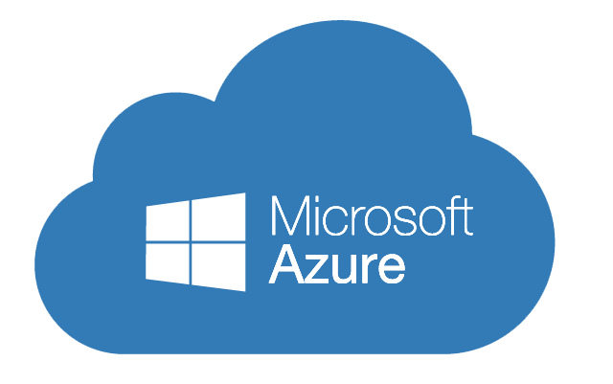
Introduction to azure
Azure, announced at Microsoft's Professional Developers Conference (PDC) in October 2008, went by the internal project codename "Project Red Dog”
formally released in February 2010 as Windows Azure, before being renamed Microsoft Azure on March 25, 2014.
Azure provides 260+ services.

Slide 2
What is Microsoft Azure?
Azure is a cloud computing platform which was launched by Microsoft in February 2010. It is an open and flexible cloud platform which helps in development, data storage, service hosting, and service management. The Azure tool hosts web applications over the internet with the help of Microsoft data centers.

Slide 3
What is Cloud Computing?
Cloud computing is a term referred to storing and accessing of data over the internet. It doesn’t store any data on the hard disk of your personal computer.
In cloud computing, you access data from a remote server.

Slide 4
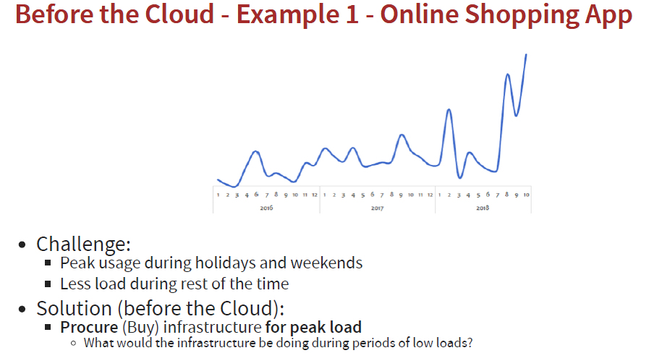

Slide 5
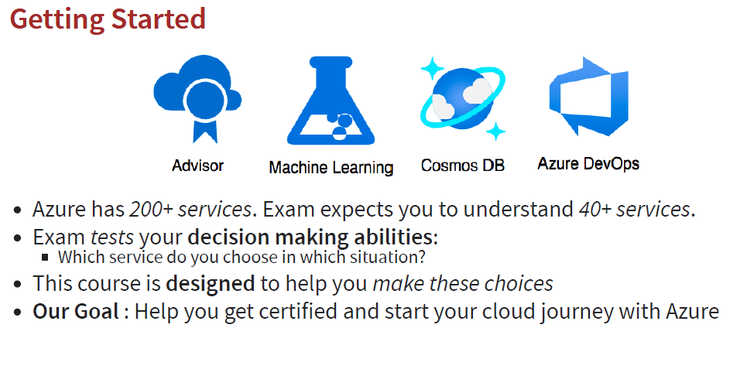

Slide 6
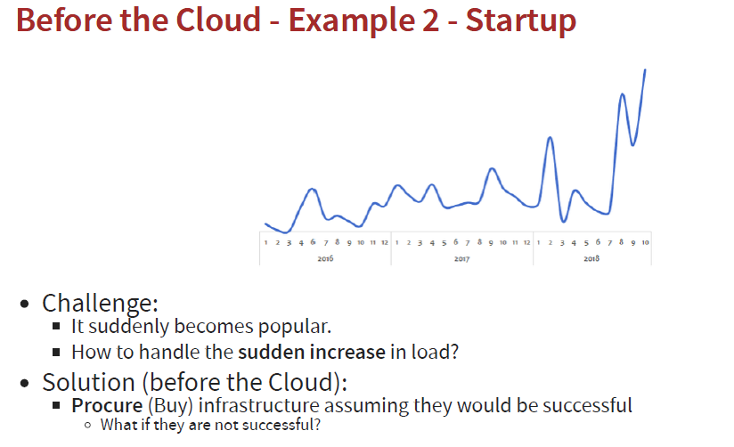

Slide 7
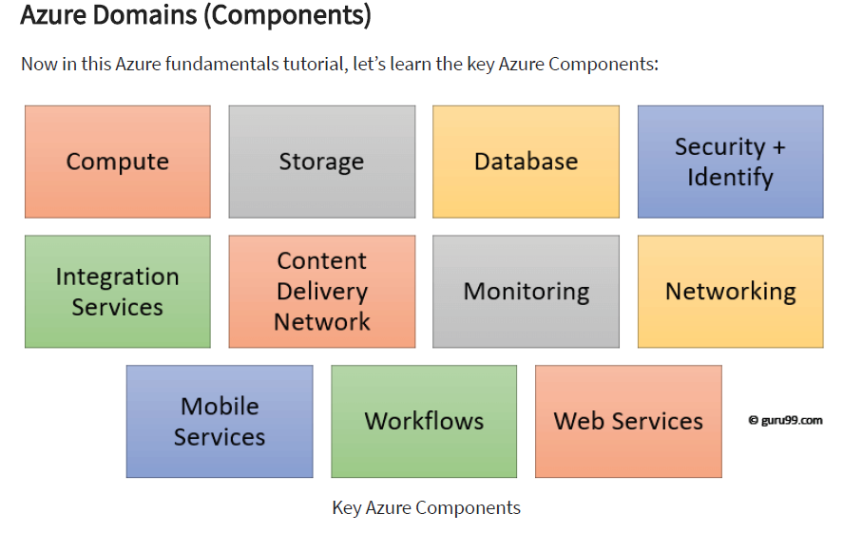

Slide 8
CLOUD DEPLOYMENT MODELS
PUBLIC CLOUD
There is no local hardware to manage or keep up-to-date in a public cloud – everything runs on your cloud provider’s hardware.
Advantages | Disadvantages
High scalability/agility | Security requirements that cannot be met by using public cloud
Pay-as-you-go pricing | Government policies, industry standards, or legal requirements which public clouds cannot meet
Not responsible for maintenance or updates of the hardware | You don’t own the hardware or services and cannot manage them as you may want to
Minimal technical knowledge to set up and use | Unique business requirements, such as having to maintain a legacy application might be hard to meet

Slide 9
PRIVATE CLOUD
In a private cloud, you create a cloud environment in your own datacenter and provide self-service access to compute resources to users in your organization. This offers a simulation of a public cloud to your users, but you remain completely responsible for the purchase and maintenance of the hardware and software services you provide.
Advantages | Disadvantages
You can ensure the configuration can support any scenario or legacy application | You have some initial CapEx costs and must purchase the hardware for startup and maintenance
You can control (and responsibility) over security | Owning the equipment limits the agility - to scale you must buy, install, and setup new hardware
Private clouds can meet strict security, compliance, or legal requirements | Private clouds require IT skills and expertise that’s hard to come by
Economies at scale and integration with Azure Security Center

Slide 10
HYBRID CLOUD
A hybrid cloud combines public and private clouds, allowing you to run your applications in the most appropriate location.
Advantages | Disadvantages
Keep any systems running and accessible that use out-of-date hardware or an out-of-date operating system | Can be more expensive than selecting one deployment model since it involves some CapEx cost up front
You have flexibility with what you run locally versus in the cloud | It can be more complicated to set up and manage
You can take advantage of economies of scale from public cloud providers for services and resources where it’s cheaper, and then supplement with your own equipment when it’s not
You can use your own equipment to meet security, compliance, or legacy scenarios where you need to completely control the environment

Slide 11
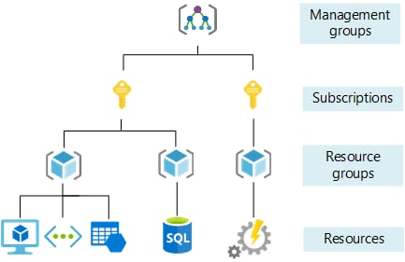
Azure Resource manager ARM

Slide 12
Managed services
IAAS
PAAS
SAAS

Slide 13
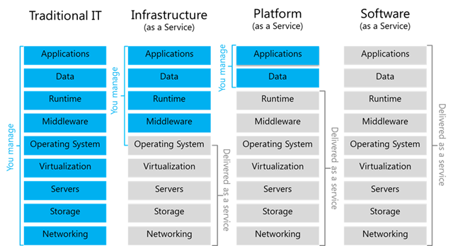
IAAS PASS SASS

Slide 14
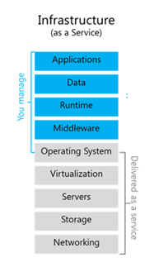
IAAS (Infrastructure As a service)
Infrastructure as a Service (IaaS) in Azure provides virtualized computing resources over the internet.
It allows users to rent virtual machines, storage, and networking infrastructure on a pay-as-you-go basis.
With IaaS, organizations can avoid the cost and complexity of owning and maintaining physical servers and data centers.
Ex: virtual machines

Slide 15
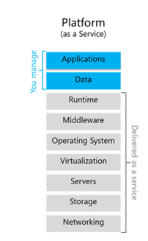
PAAS (Platform As a service)
Platform as a Service (PaaS) in Azure is a cloud computing service that provides a platform allowing customers to develop, run, and manage applications without dealing with the complexities of infrastructure management.
Ex: App service(webapp,function app), Storage account,AKS, SQL, Cosmos, Azure Devops

Slide 16
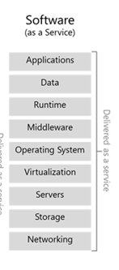
SAAS (Software As a service)
Software as a Service (SaaS) in Azure refers to cloud-based applications that are delivered and accessed over the internet.
In the context of Azure, SaaS offerings encompass a variety of software applications that are fully managed and hosted by Microsoft, allowing users to access the software without the need for installing, maintaining, or managing the underlying infrastructure.
EX: MS365,Dynamic, Azure AD

Slide 17
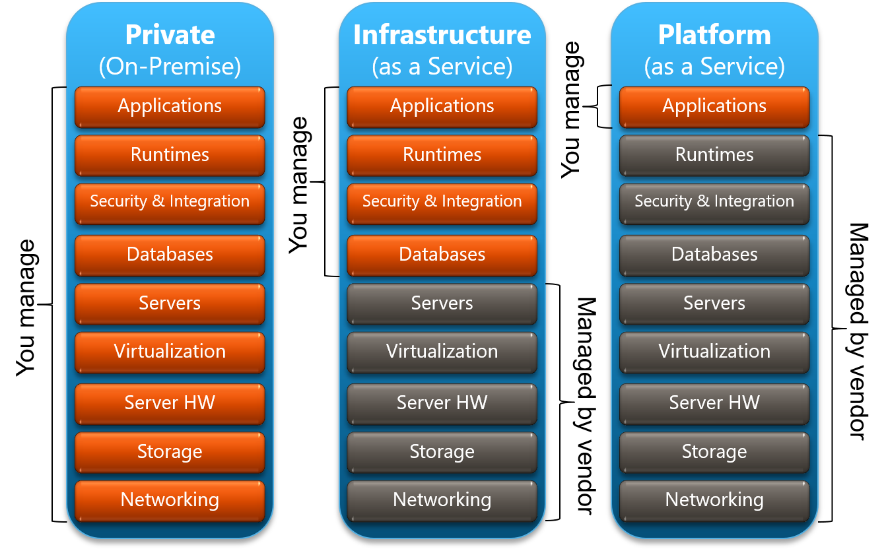

Slide 18
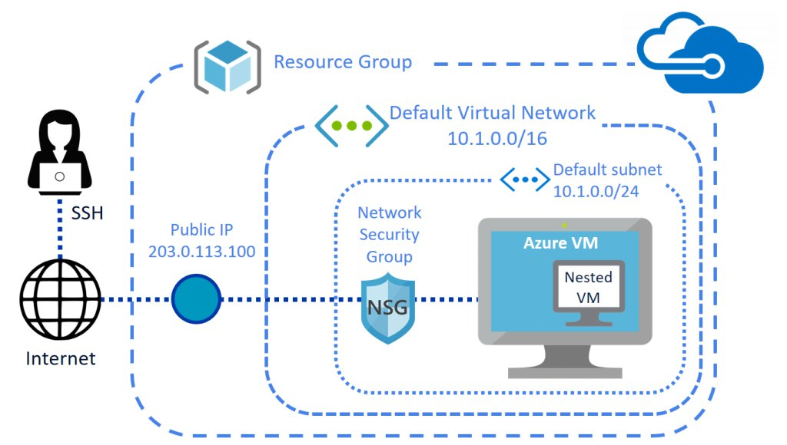

Slide 19
Azure Virtual Machine configuration
VM resize or scale: increasing the size of VM
Resource lock
VM disk attach/ditach : Adding Extra disk to VM
(disk.mgmt.msc)/diskmanagment
VM status : Running, stopped, stopped(deallocation)
VM auto shutdown :
VM Capture/snapshot
VM backup: taking schedule backups
DR- Setup
Networking

Slide 20
Capture Image Azure VM
An image can be created from a VM and then used to create multiple VMs.
For images stored in an Azure Compute Gallery (formerly known as Shared Image Gallery), you can use VMs that already have accounts created on them (specialized) or you can generalize the VM before creating the image to remove machine accounts and other machines specific information. To generalize a VM, see Generalized a VM. For more information, see Generalized and specialized images.
Steps for capture:
Select your VM from the list. (webserver, printserver)
“Install-WindowsFeature -Name Web-Server –IncludeManagementTools”
“Install-WindowsFeature -Name Print-Services –IncludeManagementTools”
generalize the OS disk for Linux or Windows. Sysprep command.
On the VM’s page, in the upper menu, click “Capture.”
Sysprep removes all preload and personal account and security info (generalization)
The Create an image page will appear. Here are the key settings:
Resource group: Choose an existing group or create a new one.
Gallery: Optionally, select a gallery to share the image version.
Image definition: Choose an existing one or create a new definition.
Image version number: Set the version (e.g., 1.0.0).
End of life date: Specify when older images should be retired.
Replication: Select regions for image replication.
If desired, check the box to automatically delete the source VM after creating the image (though this is not recommended).
Click “Create” to capture the VM image

Slide 21
Generalizing azure VM?
Generalizing an Azure virtual machine (VM) is a process that prepares it for capturing as an image or template. When you generalize a VM, it removes machine-specific information, such as user accounts, network configurations, and other unique identifiers. This allows you to create multiple instances with the same configuration from the generalized image
Spot instance :
Virtual Machines allow you to provision unused Azure compute capacity at deep discounts—up to 90% compared to pay-as-you-go prices

Slide 22
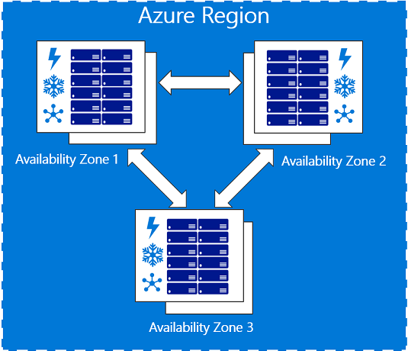
Azure Region
set of data centers deployed within a latency-defined perimeter and connected through a dedicated regional low-latency network.
Each regions may have one or more Availability zones, and isolated from other region.
Geographical locations such as US, London, India .
Availability zones
An Availability Zone is a physically separate zone within an Azure region.
Each Availability Zone has a distinct power source, network, and cooling. Deploying VMs across availability zones helps to protect an application against datacenter-wide failures
All the availability zones in regions are interconnected.

Slide 23
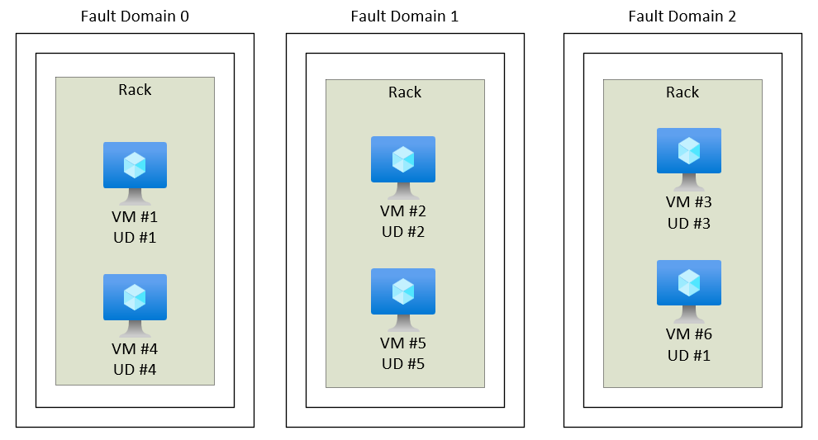
Availability sets: are logical groupings of VMs that reduce the chance of correlated failures bringing down related VMs at the same time. Availability sets place VMs in different fault domains for better reliability, especially beneficial if a region doesn't support availability zones.
When using availability sets, create two or more VMs within an availability set. Using two or more VMs in an availability set helps highly available applications and meets the 99.95% Azure SLA. There's no extra cost for using availability sets, you only pay for each VM instance you create.

Slide 24
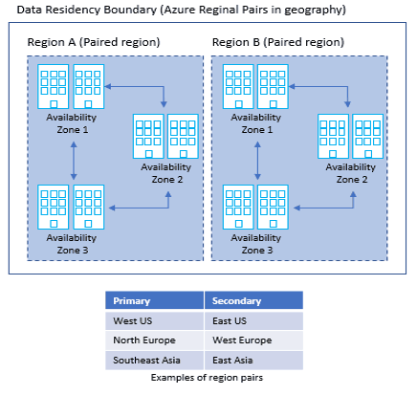
Azure regional pairs
An Azure Region Pair is a relationship between 2 Azure Regions within the same geographic region for disaster recovery purposes.
If one of the regions were to experience a disaster or failure, then the services in that region will automatically failover to that regions secondary region in the pair.
For example, North Central US region’s pair is South Central US.

Slide 25
Geography Paired regions
asia East Asia / Southeast Asia
Brazil Australia East / Australia Southeast
Canada Australia Central / Australia Central 2
China Brazil South (1) / South Central US
China Canada Central / Canada East
Europe China North / China East
France China North 2 / China East 2
Germany North Europe (Ireland) / West Europe (Netherlands)
India France Central / France South
India Germany Central / Germany Northeast
Japan Central India / South India
Korea West India / South India
North America Japan East / Japan West
North America ` Korea Central / Korea South
North America East US / West US
North America East US 2 / Central US
South Africa North Central US / South Central US
UK West US 2 / West Central US
United Arab Emirates South Africa North / South Africa West
US Department of Defense UK West / UK South
US Government UAE North / UAE Central
US Government US DoD East / US DoD Central
US Government US Gov Arizona / US Gov Texas

Slide 26
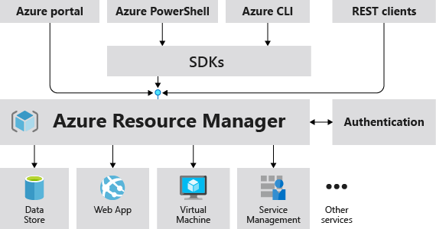
Azure Resource Manager
Azure Resource Manager is the deployment and management service for Azure.
It provides a management layer that enables you to create, update, and delete resources in your Azure account.
You use management features, like access control, locks, and tags, to secure and organize your resources after deployment.
resource - A manageable item that is available through Azure. Virtual machines, storage accounts, web apps, databases, and virtual networks are examples of resources. Resource groups, subscriptions, management groups, and tags are also examples of resources.
resource group - A container that holds related resources for an Azure solution. The resource group includes those resources that you want to manage as a group.All the resources in your resource group should share the same lifecycle. You deploy, update, and delete them together
resource provider - A service that supplies Azure resources. For example, a common resource provider is Microsoft.Compute, which supplies the virtual machine resource. Microsoft.Storage is another common resource provider.

Slide 27
Azure Virtual Machines
A virtual machine, or VM, is a software emulation of a physical computer. A snapshot of a running VM is called an image. Azure provides images for Windows and several flavors of Linux. You can also create your own preconfigured images to make deployments go faster.
A virtual machine is defined by a number of factors, including its size and location. Before you bring up your VM, let’s briefly cover what’s involved.
• Size: A VM’s size defines its processor speed, amount of memory, initial amount of storage, and expected network bandwidth.
• Region: A region is a set of Azure data centers in a named geographic location. Every Azure resource, including virtual machines, is assigned a region. East US and North Europe are examples of regions.
• Network: A virtual network is a logically isolated network on Azure. Each virtual machine on Azure is associated with a virtual network. Azure provides cloud-level firewalls for your virtual networks called network security groups.
• Resource groups: Virtual machines and other cloud resources are grouped into logical containers called resource groups. Groups are typically used to organize sets of resources that are deployed together as part of an application or service. You refer to a resource group by its name.

Slide 28
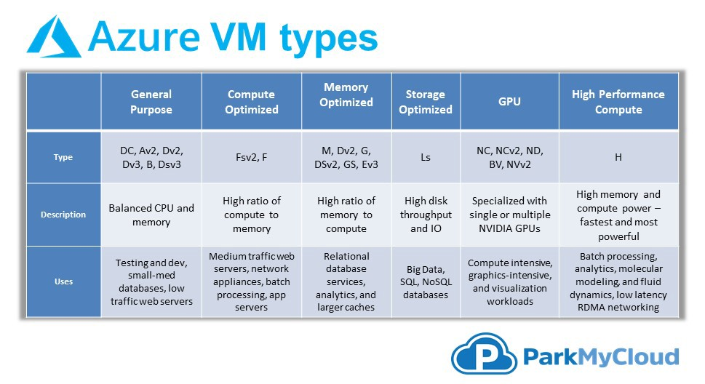

Slide 29
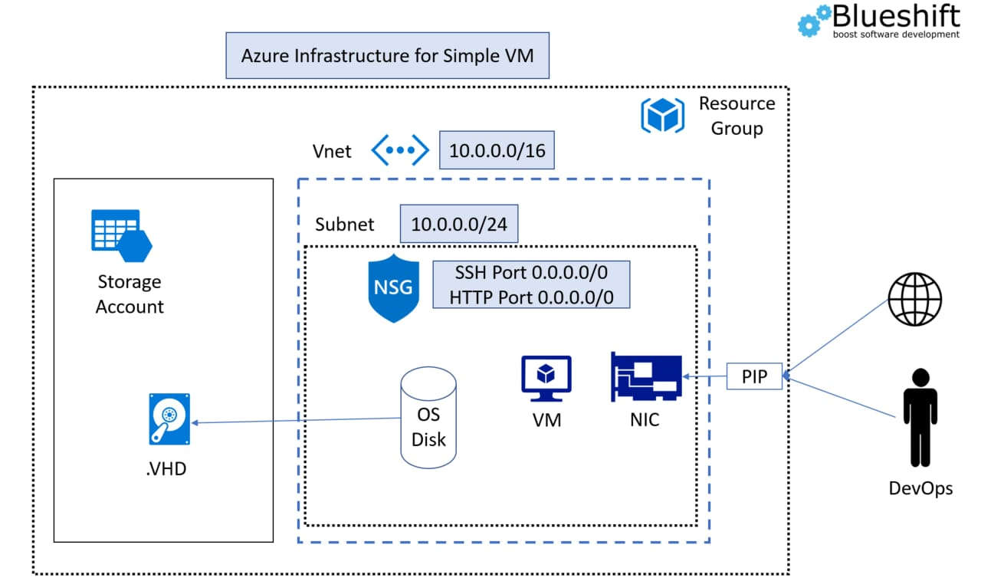

Slide 30
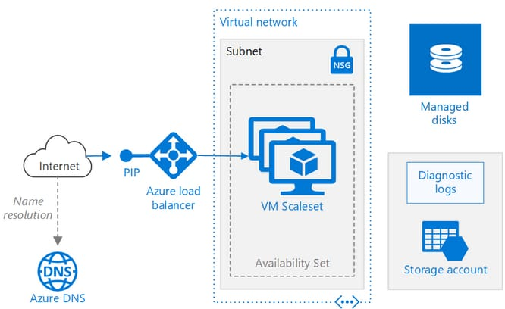

Slide 31
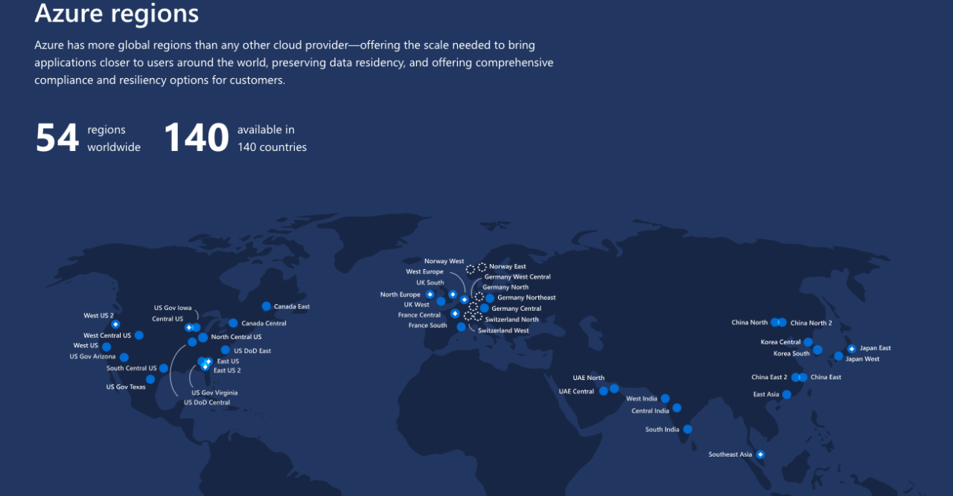

Slide 32
Class 1 Azure Networking
Notes:
Let’s start out by diving into virtual machine endpoints.

Slide 33
What is Azure Virtual Network, and Why use an Azure Virtual network?
Azure virtual network enables Azure resources to securely communicate with each other, the internet, and on-premises networks.
a virtual network include - communication of Azure resources with the internet, communication between Azure resources, communication with on-premises resources, filtering network traffic, routing network traffic, and integration with Azure services.
Communicate with the internet
All resources in a VNet can communicate outbound to the internet, by default. You can communicate inbound to a resource by assigning a public IP address or a public Load Balancer.
You can also use public IP or public Load Balancer to manage your outbound connections.
To learn more about outbound connections in Azure, see Outbound connections, Public IP addresses, and Load Balancer.

Slide 34
A public IP address is unique and visible to everyone. It ensures that you can be clearly identified on the internet. By contrast,
private IP address is only used within a private network.

Slide 35
Communicate between Azure resources
Through a virtual network:You can deploy VMs, and several other types of Azure resources to a virtual network, such as Azure App Service Environments, the Azure Kubernetes Service (AKS), and Azure Virtual Machine Scale Sets. Etc…
Through a virtual network service endpoint: direct connection. Service endpoints allow you to secure your critical Azure service resources to only a virtual network. To learn more, see Virtual network service endpoints overview.
Through VNet Peering:You can connect virtual networks to each other, enabling resources in either virtual network to communicate with each other, using virtual network peering. The virtual networks you connect can be in the same, or different, Azure regions. To learn more, see Virtual network peering.

Slide 36
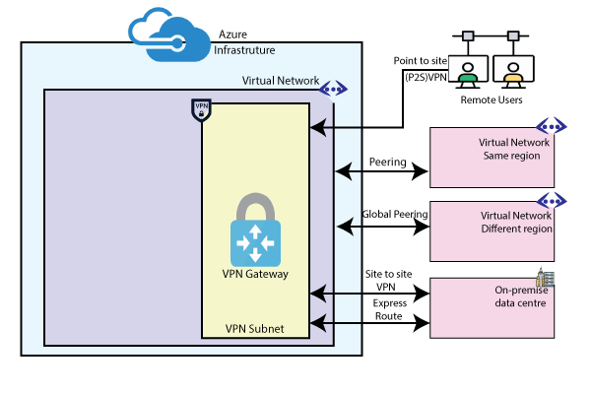
Azure VNet Connectivity

Slide 37
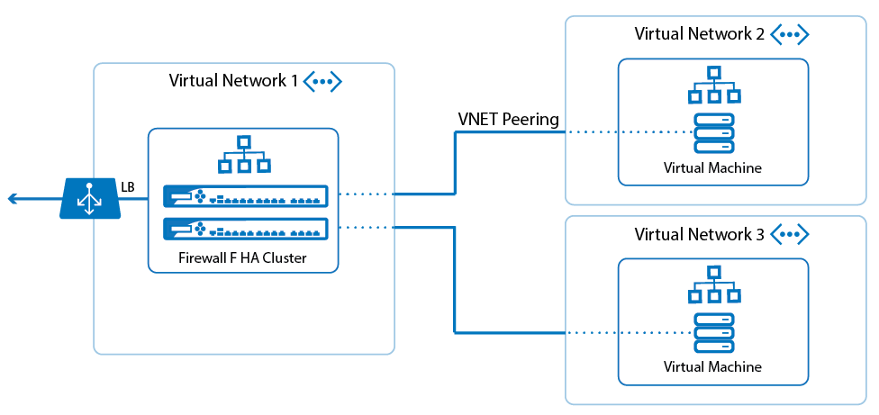

Slide 38

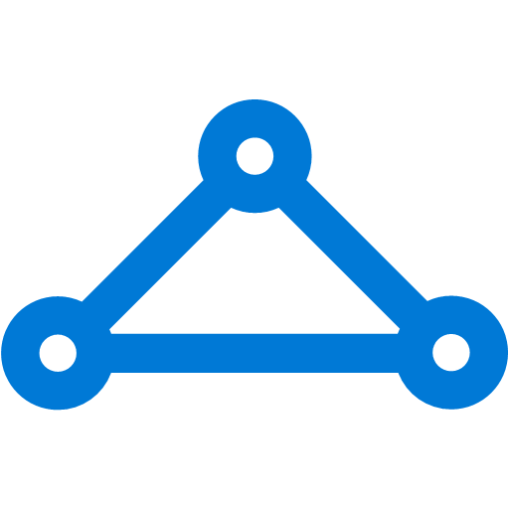
The Big (Network) Picture
Virtual Network
“Bring Your Own Network”
Segment with subnets and security groups
Control traffic flow with User Defined Routes
Azure
Virtual Network
Users
Internet
Front-End Access
Dynamic/Reserved Public IP addresses
Direct VM access, ACLs for security
Load balancing
DNS services: hosting, traffic management
DDoS protection
Backend Connectivity
Point-to-site for dev / test
VPN Gateways for secure site-to-site connectivity
ExpressRoute for private enterprise grade connectivity
Backend Connectivity
ExpressRoute
VPN Gateways

Slide 39
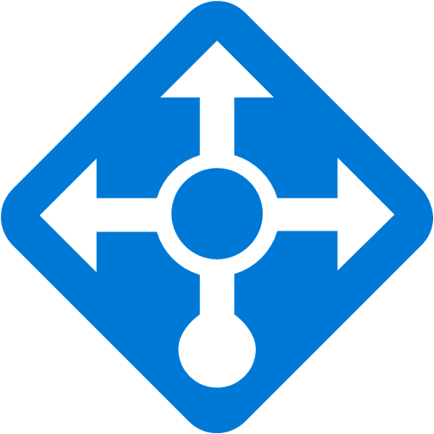





Azure Virtual Networks
10.1.1.0/24
Internet
Virtual Networks are the primary building block for Azure networking
Create subnets with your private or public IP addresses
Bring your own DNS or use Azure-provided DNS
Connect to on premises or the Internet
Control traffic flow with User Defined Routes and Network Security Groups
10.1.1.0/25
10.1.1.128/25
Front end subnet
Back end subnet
Traffic stays within MS network
Traffic to on-premises and other VNets
Storage
SQL DB

Slide 40
Components of a Virtual Network
Address Spaces (IP Prefixes)
Ipv4 = 10.10.2.3/24
The range of IP addresses available in your virtual network
Subnets
Named ranges of addresses assignable to virtual machines and cloud service instances.
DNS Servers
References to DNS servers that will be assigned to virtual machines or cloud service instances in the virtual network.
Local Network Configuration
Configuration of an remote network connected by a site-to-site VPN connection or ExpressRoute.
Notes:
Address Space
IP range that is dedicated to this network. This should sized appropriately to the network scale that will be used over a long period of time. In general practice this should be a Private address space that doesn’t overlap rest of the company’s network.
Subnets
The smaller networks that have been “carved” out of the IP address space. Typically these might be for the Web, Data, or Management tiers. Each of these have a purpose and by subnetting you can direct only the traffic that should be accessing those machines to have access.
DNS
Azure by default provides Name services to Azure VNETs, but this can be configured to use the DNS servers of the company.
Local Network Configuration
This is the address range of the network onsite that will be connecting to the Vnet via VPN.

Slide 41
VNet deployment demo

Slide 42
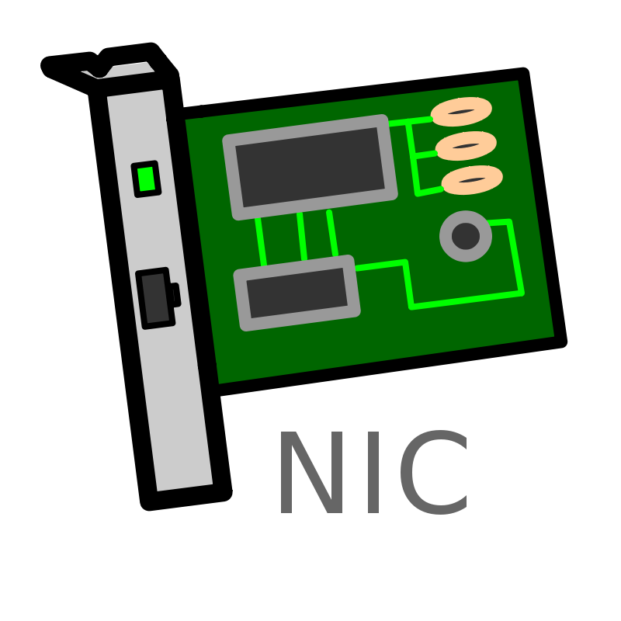
VMs and NIC
NIC connects a VM to network
VM can have one or more NICs
NIC can have:
1 Private IP – Static or Dynamic
1 Public IP – Static or Dynamic
1 LB VIP – Static or Dynamic
All NICs belong to same VNet
NICs can be in different subnets
Private IP
Private IP
primary
Public IP
LB

Slide 43
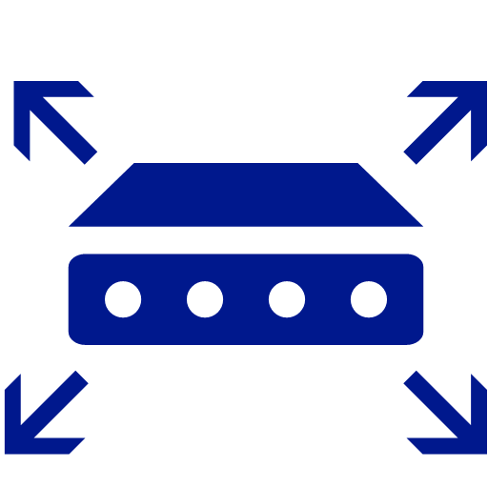
Connectivity within VNet
System routes
Direct VM to VM connectivity
Every other VM is just one hop away (logically)
Infinite scale within a region
Azure Region
Network Infrastructure
Customer VNet

Slide 44
On prem to azure Vnet peering
1. point to site Vpn: vnet connection from single point(on prem network) to azure vnet.
2. Site to site VPN: network connectivity between on prem entire network to Azure Vnet
3. express route :

Slide 45
Vpn network
Gateway subnet: A gateway IP refers to a device on a network which sends local network traffic to other networks. The subnet mask number helps to define the relationship between the host (computers, routers, switches, etc.) and the rest of the network.
Virtual network gateway: is VPN gateway

Slide 46
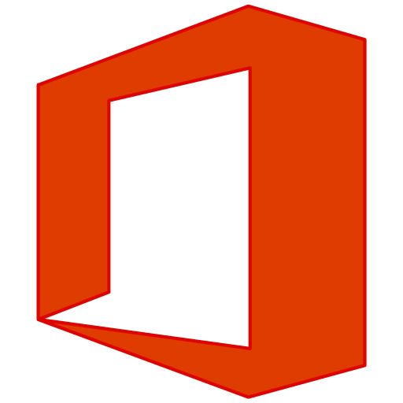

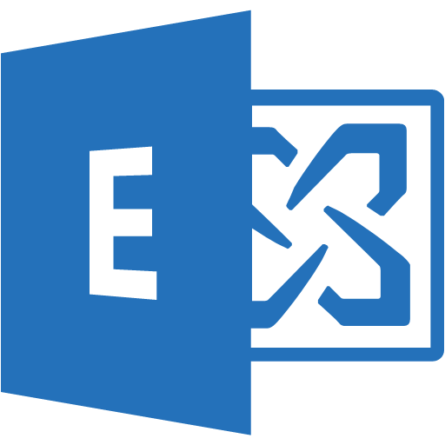
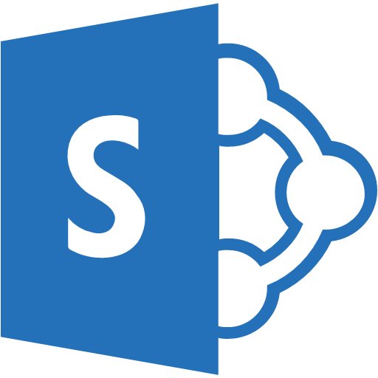
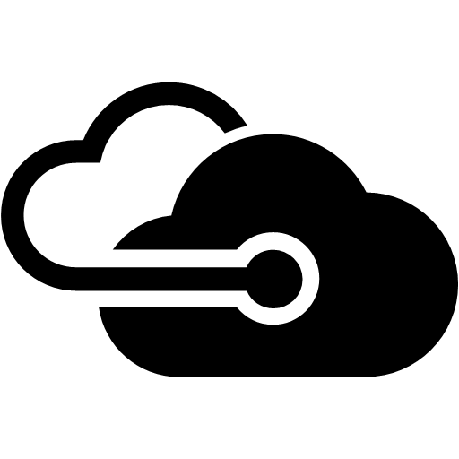

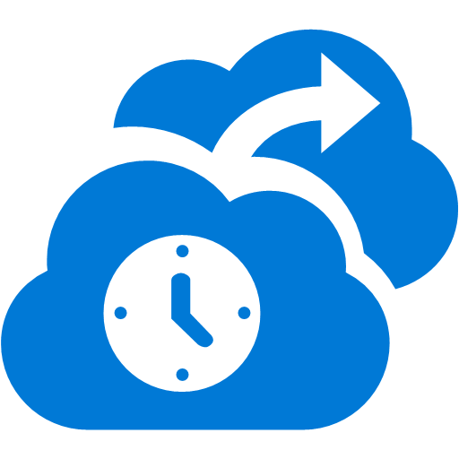


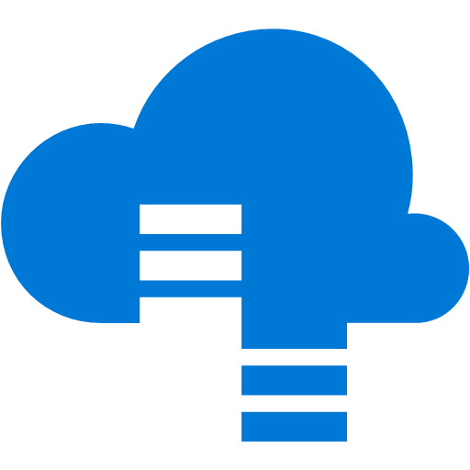

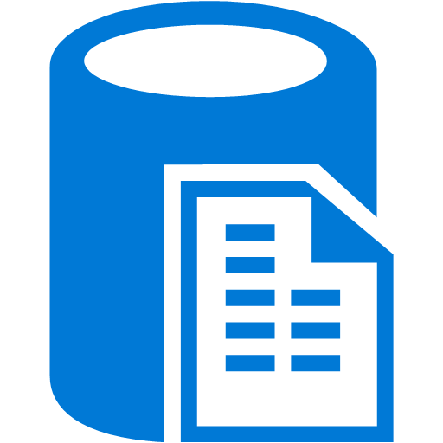

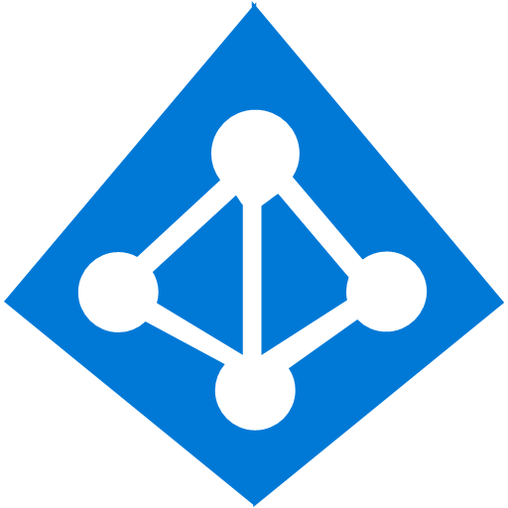

ExpressRoute connectivity
Partner Edge
Microsoft Edge
Customer’s network
Customer’s connection
Traffic to Office 365 Services and soon CRM Online
Traffic to public IP addresses in Azure
Traffic to Virtual Networks
Notes:
Mention recommendation update on MSFT peering!
2 physical lines, one logical connection

Slide 47
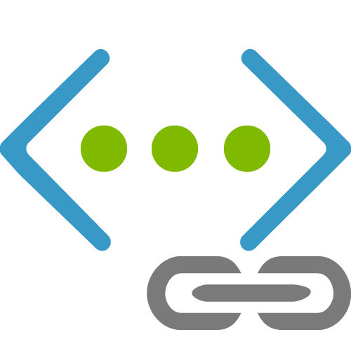
VNet to VNet peering
Azure Region
10.0.0.0/16
Private connectivity from VM to VM in different VNets
Connection through the gateway
NEW
VNet Peering GA
Direct full mesh connectivity
Latency and throughput at par as single VNet!
PEER
IPSec VPN Tunnel
10.0.1.0/16

Slide 48
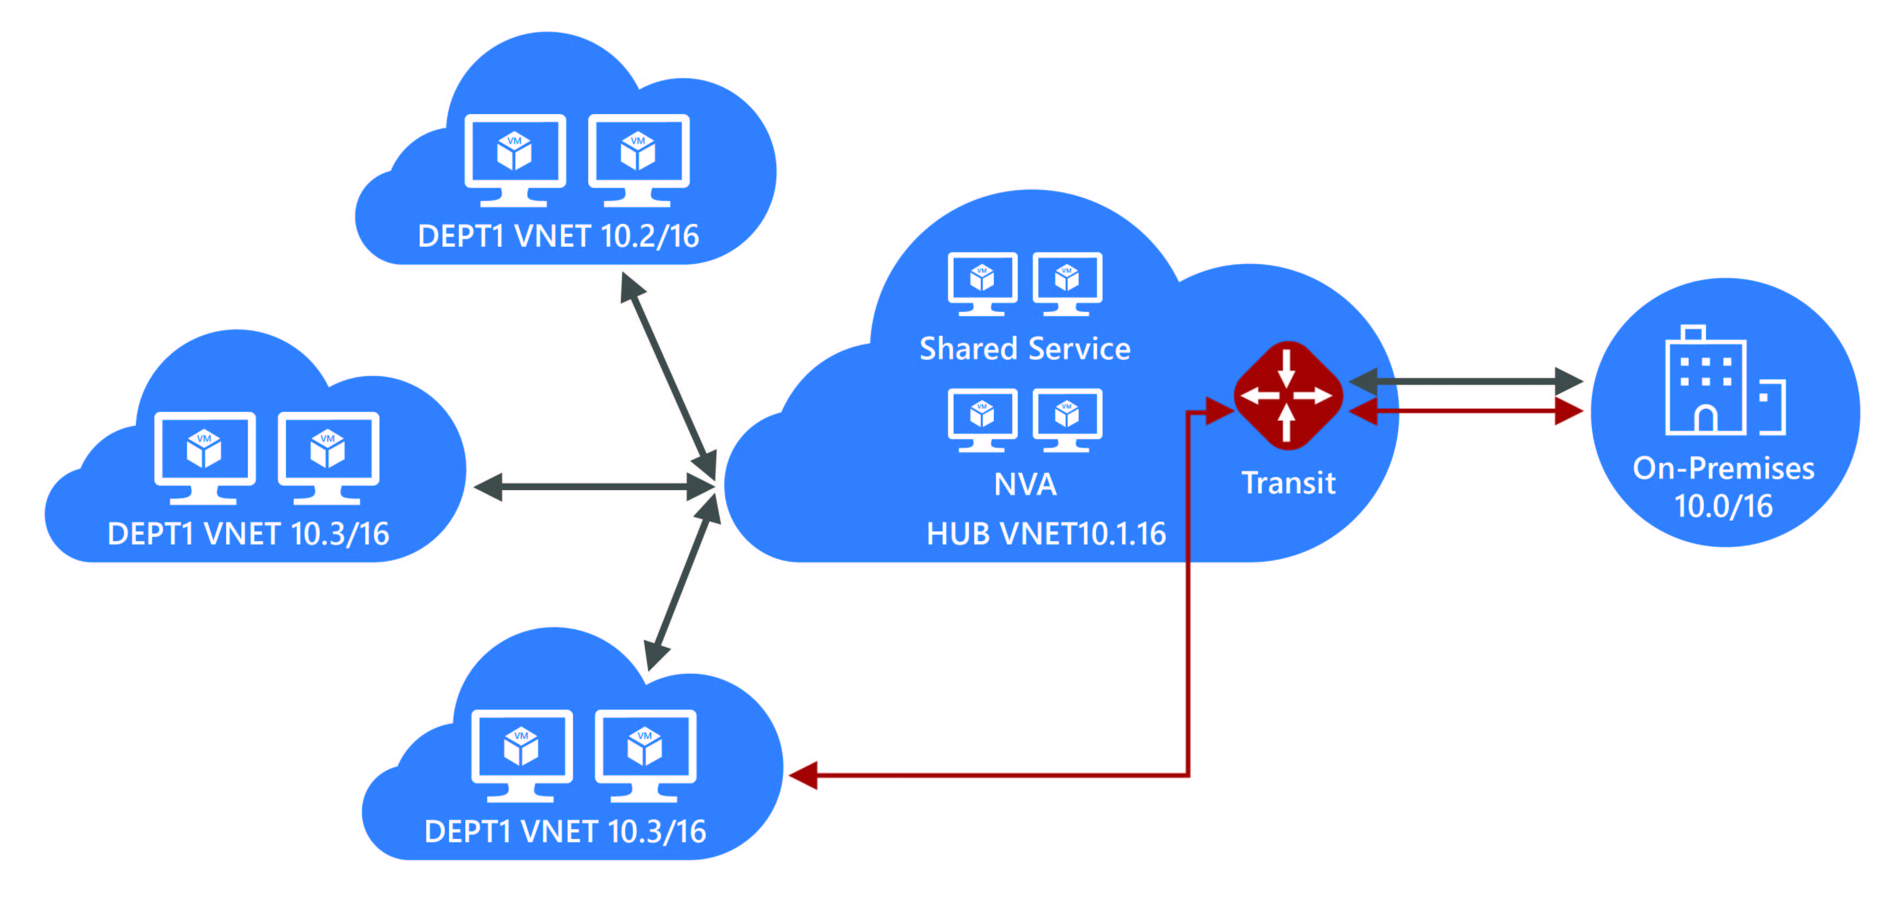
VNet Peering Hub and spoke
Central VNet (Hub) peers with spoke Vnets
Gateway and NVA Transit
UDR next hop IP in central VNet
Consolidate shared services
Virtual DMZ

Slide 49
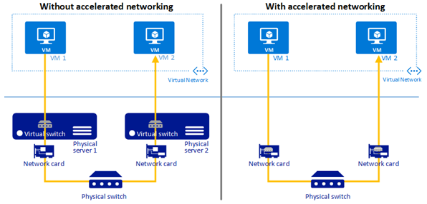
Accelerated Networking
Provides SRIOV to the VM
10x latency improvement
Increased packets per second (PPS)
Up to 25 Gbps throughput

Slide 50
Point to site VPN
Create RG in region (east us example)
Create Vnet in same region
Create gateway subnet inside Vnet
Create VM and attach to that Vnet
Create VNG in same region
Generate self sign root certificate with powershell command
Generate self sign client certificate with powershell command.
Go to VNG and configure point to side VPN.
Put the root certificate name and certificate data and save.
Download the VPN client and connect.
Take the RDP of the azure VM with private IP.

Slide 51
Security - Network Security Group (NSG)
Prioritized set of rules
Applied at the NIC and/ or Subnet
Default Tags: Virtual Network, Internet, AzureLoadBalancer
Default rules: 65000 and above
VM1
VM2
NSG 1
Pri | Access | Src | Port | Dst | Port | Protocol
Virtual Subnet
NSG 2
Pri | Access | Src | Port | Dst | Port | Protocol

Slide 52
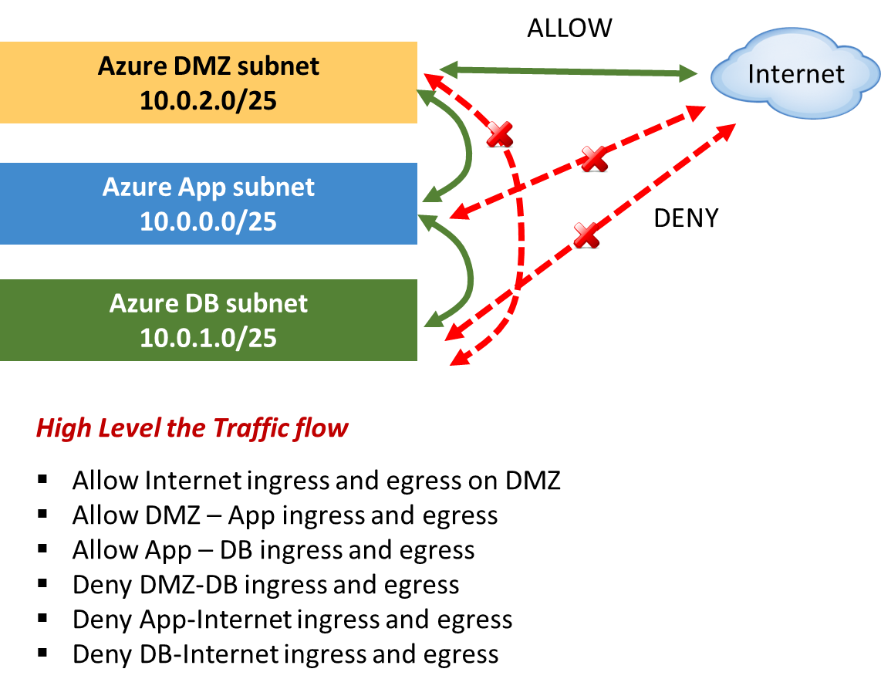
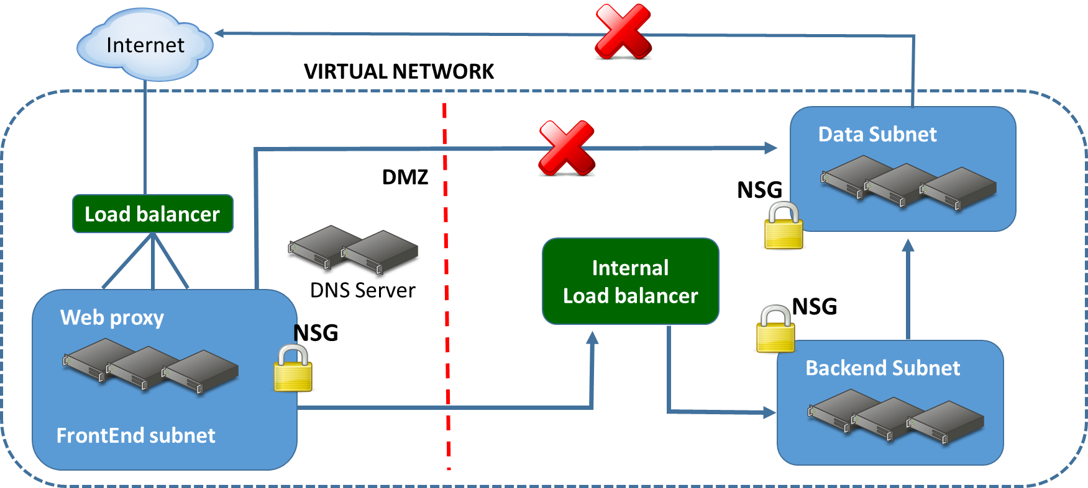
NSGs in a multitier topology

Slide 53
Default rules
Inbound
Name | Priority | Source IP | Source Port | Destination IP | Destination Port | Protocol | Access
ALLOW VNET INBOUND | 65000 | VIRTUAL_NETWORK | * | VIRTUAL_NETWORK | * | * | ALLOW
ALLOW AZURE LOAD BALANCER INBOUND | 65001 | AZURE_LOADBALANCER | * | * | * | * | ALLOW
DENY ALL INBOUND | 65500 | * | * | * | * | * | DENY
Outbound
Name | Priority | Source IP | Source Port | Destination IP | Destination Port | Protocol | Access
ALLOW VNET OUTBOUND | 65000 | VIRTUAL_NETWORK | * | VIRTUAL_NETWORK | * | * | ALLOW
ALLOW INTERNET OUTBOUND | 65001 | * | * | INTERNET | * | * | ALLOW
DENY ALL OUTBOUND | 65500 | * | * | * | * | * | DENY
Example
Name | Priority | Source IP | Source Port | Destination IP | Destination Port | Protocol | Access
WEB | 100 | INTERNET | * | * | 80 | TCP | ALLOW

Slide 54
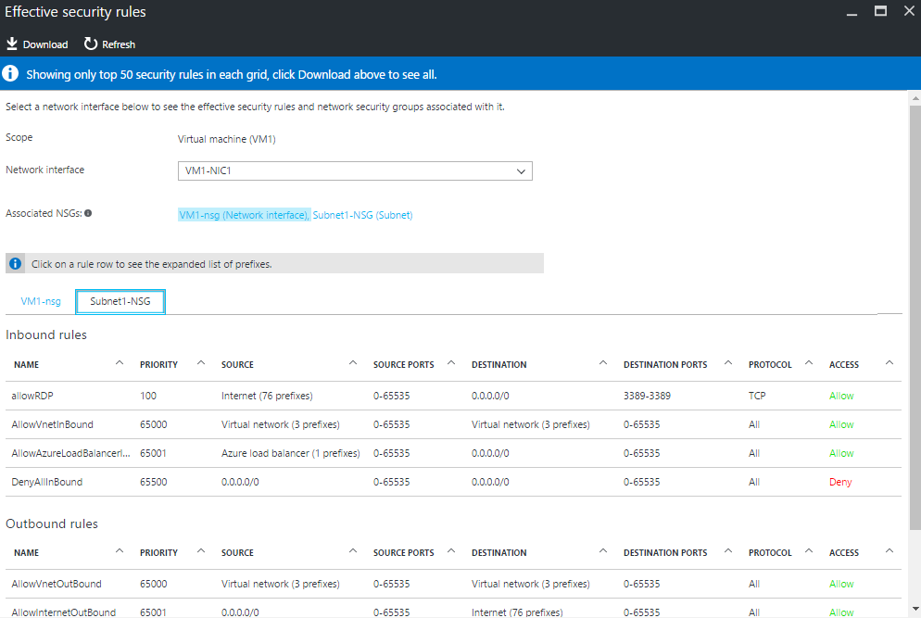
Who is blocking me - Trouble shooting NSG rules
Effective rules applied on the NIC
Consolidated view of NIC and Subnet NSGs
Expanded System tags

Slide 55

Cross premises connectivity overview
Azure
Azure
P2S SSTP tunnels
Virtual Network
Internet
Backend
Mid-tier
Frontend
IPsec S2S VPN tunnels
Private WAN
ExpressRoute

Slide 56
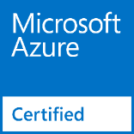
Network Virtual Appliances
Overview
VMs that perform specific network functions
Focus: Security (Firewall, IDS , IPS), Router/VPN, ADC (Application Delivery Controller), WAN optimization
Typically Linux or FreeBSD-based platforms
Scenarios
IT Policy and compliance—consistency between on-premises and Azure
Supplement/complement Azure capabilities
Azure marketplace
Available through Azure Certified Program to ensure quality and simplify deployment
Notes:
NVA & UDR for HA
NVA per VNet

Slide 57
Internal and External load balancing
Enables load balancing among VMs with private IP addresses
Accessible only from
Within customer’s cloud service
Customer’s Vnets
Customer's on-premises Vnets
Multi-tier applications with internal facing tiers require ILB
HA LOB apps
SQL Always On
Internet
Microsoft Azure
Public VIP
Customer Virtual Network
External load balancer
Customer on-premises
Internal VIP
Internal
load balancer
Back end
Front end

Slide 58


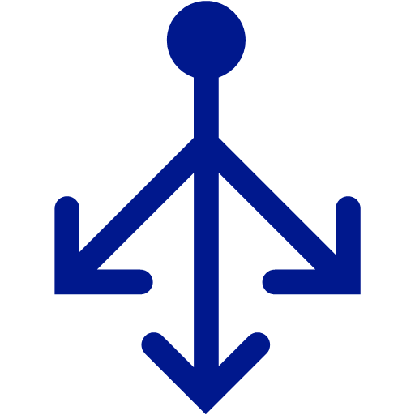

MultiTier application
Virtual Network
Internet
Frontend Subnet
DMZ
Network Virtual Appliance
Application Subnet
APP
Backend Subnet
Load Balancer
DB

Slide 59
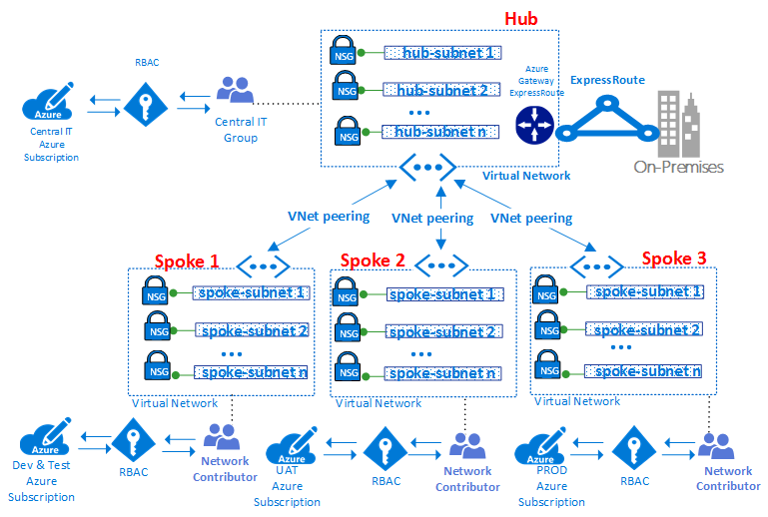
Hub and Spoke
Management & billing segregation
Compliance

Slide 60
VNet deployment demo

Slide 61
Communicate with on-premises resources
Point-to-site virtual private network (VPN): Established between a virtual network and a single computer in your network.
The communication between your computer and a virtual network is sent through an encrypted tunnel over the internet.
Site-to-site VPN: Established between your on-premises VPN device and an Azure VPN Gateway that is deployed in a virtual network.
The communication between your on-premises VPN device and an Azure VPN gateway is sent through an encrypted tunnel over the internet.
Azure ExpressRoute: Established between your network and Azure, through an ExpressRoute partner. This connection is private. Traffic does not go over the internet.

Slide 62
Point to site VPN
Gateway subnet: containing a ip address that uses vnet gateway resources and services
Virtual network gateway: send encrypted traffic between Azure Vnet to onprem server/localPC

Slide 63
Point to site VPN
STEP BY SETP TO SET UP POINT TO SITE
Create RG in region (east us example)
Create Vnet in same region
Create gateway subnet inside Vnet
Create VM and attach to that Vnet
Create VNG in same region
Generate self sign root certificate with powershell command
Generate self sign client certificate with powershell command.
Go to VNG and configure point to side VPN.
Put the root certificate name and certificate data and save.
Download the VPN client and connect.
Take the RDP of the azure VM with private IP.

Slide 64
#self signed root certificate
$cert = New-SelfSignedCertificate -Type Custom -KeySpec Signature `
-Subject "CN=P2SRootCert" -KeyExportPolicy Exportable `
-HashAlgorithm sha256 -KeyLength 2048 `
-CertStoreLocation "Cert:\CurrentUser\My" -KeyUsageProperty Sign -KeyUsage CertSign
#client side cerfiticate
New-SelfSignedCertificate -Type Custom -DnsName P2SChildCert -KeySpec Signature `
-Subject "CN=P2SChildCert" -KeyExportPolicy Exportable `
-HashAlgorithm sha256 -KeyLength 2048 `
-CertStoreLocation "Cert:\CurrentUser\My" `
-Signer $cert -TextExtension @("2.5.29.37={text}1.3.6.1.5.5.7.3.2")

Slide 65
Filter network traffic
Network security groups: Network security groups and application security groups can contain multiple inbound and outbound security rules that enable you to filter traffic to and from resources by source and destination IP address, port, and protocol.
Network virtual appliances: A network virtual appliance is a VM that performs a network function, such as a firewall, WAN optimization, or other network function. To view a list of available network virtual appliances that you can deploy in a virtual network, see Azure Marketplace.
NAT GATEWAY: (NAT gateway for outbound internet access for resources in the virtual network) Network adderess translation
NAT gateway provides outbound internet connectivity for one or more subnets of a virtual network. Once NAT gateway is associated to a subnet, NAT provides source network address translation (SNAT) for that subnet. NAT gateway specifies which static IP addresses virtual machines use when creating outbound flows.
Nic: network interface card:

Slide 66
Azure Loadbalncer

Slide 67
The term load balancing refers to the distribution of workloads across multiple computing resources. Load balancing aims to optimize resource use, maximize throughput, minimize response time, and avoid overloading any single resource. It can also improve availability by sharing a workload across redundant computing resources.
Azure provides various load balancing services that you can use to distribute your workloads across multiple computing resources
Application Gateway,
Front Door,
Load Balancer, and
Traffic Manager.
This article describes how you can use the Azure Load Balancing hub page in the Azure portal to determine an appropriate load-balancing solution for your business needs.

Slide 68
Global versus regional
Global load-balancing services distribute traffic across regional backends, clouds, or hybrid on-premises services. load balance between application stamps, endpoints, or scale-units hosted across different regions/geographies.
Regional load-balancing services distribute traffic within virtual networks across virtual machines (VMs) or zonal and zone-redundant service endpoints within a region. load balance between VMs, containers, or clusters within a region in a virtual network.
Service Global/regional Recommended traffic
Azure Front Door Global HTTP(S)
Traffic Manager Global non-HTTP(S)
Application Gateway Regional HTTP(S)
Azure Load Balancer Regional non-HTTP(S)

Slide 69
Front Door is an application delivery network that provides global load balancing and site acceleration service for web applications. It offers Layer 7 capabilities for your application like SSL offload, path-based routing, fast failover, caching, etc. to improve performance and high-availability of your applications.
Traffic Manager is a DNS-based traffic load balancer that enables you to distribute traffic optimally to services across global Azure regions, while providing high availability and responsiveness. load balances only at the domain level it can't fail over as quickly as Front Door, because of common challenges around DNS caching and systems not honoring DNS TTLs.

Slide 70
Application Gateway provides application delivery controller (ADC) as a service, offering various Layer 7 load-balancing capabilities. Use it to optimize web farm productivity by offloading CPU-intensive SSL termination to the gateway.
Azure Load Balancer is a high-performance, ultra low-latency Layer 4 load-balancing service (inbound and outbound) for all UDP and TCP protocols. It is built to handle millions of requests per second while ensuring your solution is highly available. Azure Load Balancer is zone-redundant, ensuring high availability across Availability Zones.

Slide 71
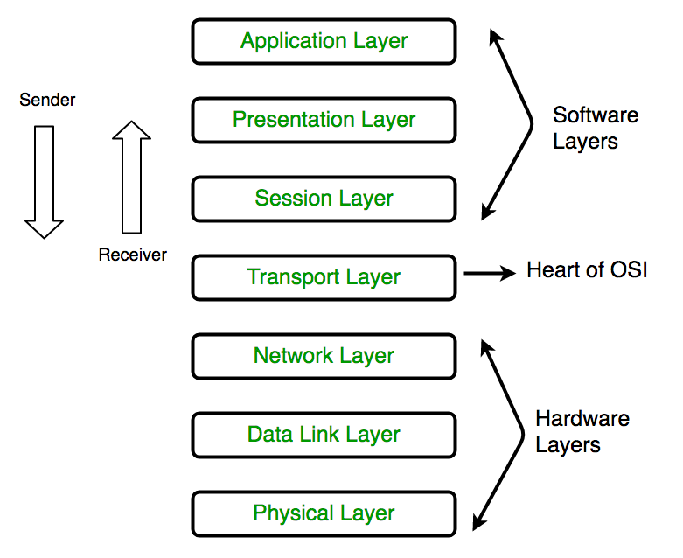
open systems interconnection (OSI) model

Slide 72
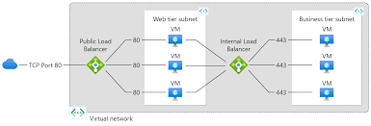
Types of load balancers
1. internal load balancer:
An internal (or private) load balancer is used where private IPs are needed at the frontend only. Internal load balancers are used to load balance traffic inside a virtual network
2. external load balancer:
Azure Load Balancer is a high-performance, ultra low-latency Layer 4 load-balancing service (inbound and outbound) for all UDP and TCP protocols. It is built to handle millions of requests per second while ensuring your solution is highly available.

Slide 73
Route network traffic
Route tables: You can create custom route tables with routes that control where traffic is routed to for each subnet.
Border gateway protocol (BGP) routes: If you connect your virtual network to your on-premises network using an Azure VPN Gateway or ExpressRoute connection, you can propagate your on-premises BGP routes to your virtual networks.
Note : There is no charge for using Azure VNet; it is free of cost. Standard charges are applicable for resources,

Slide 74
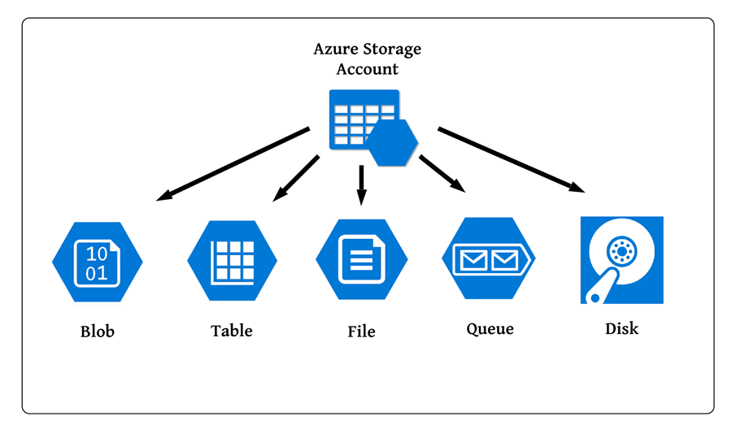
Managed Cloud Storage Solution
Highly available, durable and massively scalable (upto few PetaBytes)

Slide 75
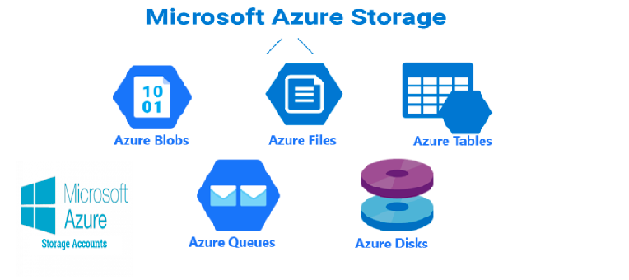

Slide 76
Core Storage Services:
Azure Disks: Block storage (hard disks) for Azure VMs
Azure Files: File shares for cloud and on-premises
Azure Blobs: Object store for text and binary data
Azure Queues: Decouple applications using messaging
Azure Tables: NoSQL store (Very Basic)
Prefer Azure Cosmos DB for NoSQL
(PRE-REQUISITE) Storage Account is needed for Azure Files,
Azure Blobs, Azure Queues and Azure Tables

Slide 77
Access tiers are: Hot, Cool, Cold, and Archive
Hot
Highest storage costs, but lowest access costs
Store data that is accessed frequently
By default, new storage accounts are created in the hot tier
Cool
Lower storage costs, but higher access costs
Store data that is infrequently accessed (at least 30 days)
You can use a cool access tier for short-term backup.
Cold
Lower storage costs and higher access costs compared to the cool tier.
Store data that is rarely accessed (at least 90 days).
You can use a cold access tier for storing large data sets in a cost-effective manner.
Archive
Lowest storage costs, but the highest retrieval costs
Store data that is rarely accessed (at least 180 days)
Data needs to be stored for a long time.

Slide 78
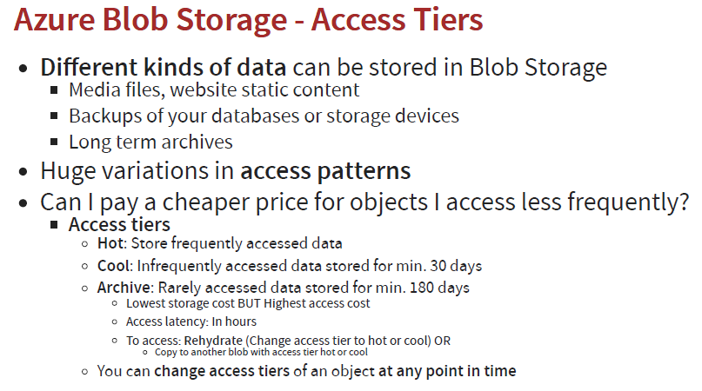
hot storage is costlier than cool storage in terms of storage. But cool storage is more expensive in terms of access. Archive storage is used for archiving the documents into storage, which is not accessed

Slide 79
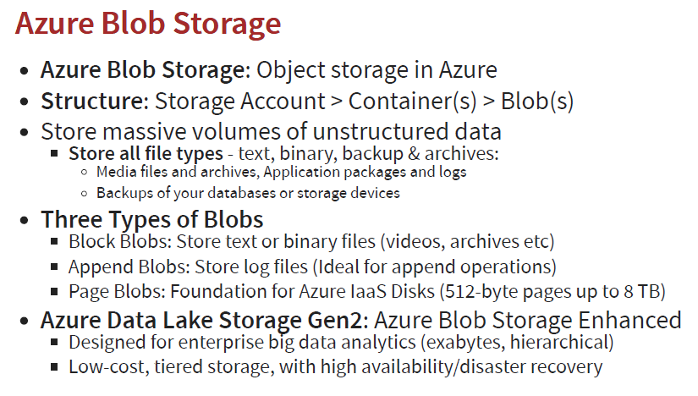

Slide 80
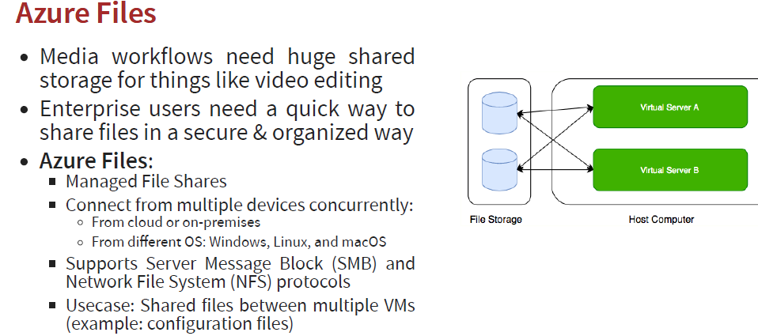

Slide 81


Slide 82
Azure Storage Replication
It copies our data to stay protected from transient hardware failure, network or power outages, and massive natural disasters to man-made vulnerabilities.
Azure creates some copies of our data and stores it at different places. Based on the replication strategy
LRS (Local Redundant Storage): So, if we go with the local-redundant storage, the data will be stored within the data center. If the data center or the region goes down, the data will be lost.
ZRS (Zone-Redundant Storage): The data will be replicated across data centers but within the region.
the data is always available within the data center, even if one node is not available. OR data will be available also if the entire data center goes down because the data is already copied in another data center within the region.
However, if the region itself is gone, then you will not get the data access.
Notes:
Redundant: Excessive, spare surplus

Slide 83
GRS (global-redundant storage): To protect our data against region-wide failures. We can go for global-redundant storage. In this case, the data will be replicated in the paired region within the geography. And in case if we want to have read-only access to the data that is copied to another region, then, in that case,
RA-GRS (Read Access global-redundant storage). We can get different things in terms of durability, as we can see in this table below.

Slide 84


Slide 85




Slide 86


Slide 87
Storage Account Type | Supported Services | Supported Performance Tiers | Supported Access Tiers | Replication Options | Deployment Model | Encryption
General- purpose V2 | Blob, File, Queue, Table, Disk, and Data Lake Gen2 | Standard, Premium | Hot, Cool,Clod Archive | LRS, GRS, RA-GRS, ZRS, GZRS (preview), RA-GZRS (preview) | Resource Manager | Encrypted
General- purpose V1 | Blob, File, Queue, Table, and Disk | Standard, Premium | N/A | LRS, GRS, RA-GRS | Resource Manager, Classic | Encrypted
BlockBlob Storage | Blob (block blobs and append blobs only) | Premium | N/A | LRS, ZRS | Resource Manager | Encrypted
FileStorage | File only | Premium | N/A | LRS, ZRS | Resource Manager | Encrypted
BlobStorage | Blob (block blobs and append blobs only) | Standard | Hot, Cool, Cold, Archive | LRS, GRS, RA-GRS | Resource Manager | Encrypt

Slide 88
Storage account endpoints
Whenever we create a storage account, we will get an endpoint to access the data within the storage account. So each object that we stored in Azurestorage has an address, which includes your unique account name and the combination of an account name, and service endpoint, which forms the endpoint for your storage account.
For example, if your general-purpose account name is mystorageaccount then generally the default endpoints for different services looks like:
Azure Blob storage: http://mystorageaccount.blob.core.windows.net.
Azure Table storage: http://mystorageaccount.table.core.windows.net
Azure Queues storage: http://mystorageaccount.queue.core.windows.net
Azure files: http://mystorageaccount.file.core.windows.net
In case if we want to map our custom domain for these, we can still do that. We can use our custom domain in reference to these storage service endpoints.

Slide 89
Storage account migrataion
You can migrate data manually using:
AzCopy uses a command-line utility
Data Movement Library is designed for high-performance, reliable, and easy data transfer operations similar to AzCopy
REST API or client library lets you create a custom application to migrate your data

Slide 90


Slide 91

Managed Services

Slide 92


Slide 93


Slide 94


